Slide 1


Slide 2

Logo
Incorporated throughout the website design
Influences the website design
Represents music through the flow of the lines and handle

Slide 3
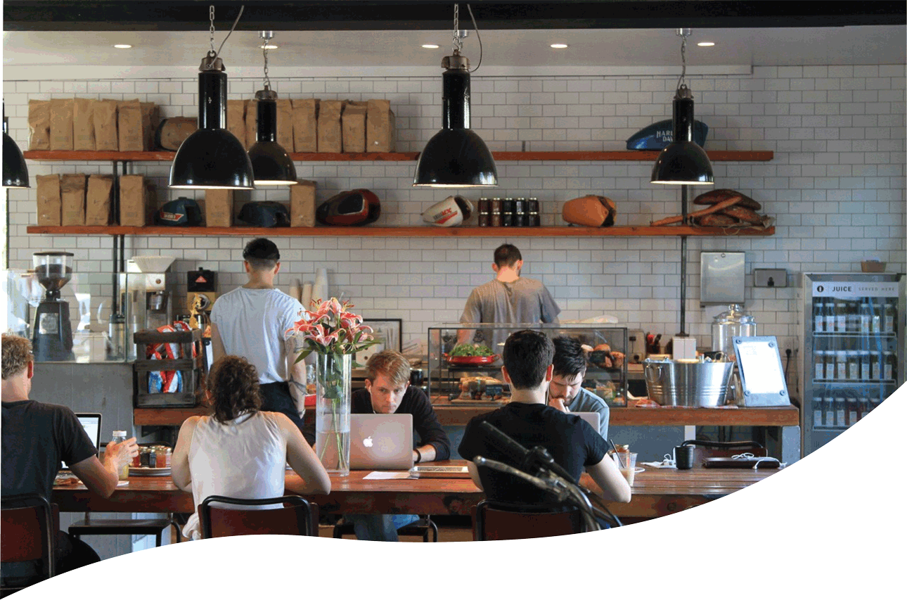
Design
Uniformity through formatting
Each page creates a different user experience through color
Typeface, colors, and framing reinforces the logo

Slide 4

Meeting Client’s Expectations
Event Calendar
Personalized message
Modern design
Information more accessible to the community
Advertised employment opportunities

Slide 5

Why buy my site?
Responsive to mobile
Easy to navigate
Incorporates JavaJam through every aspect of the website design

